Slide 1

PRESENTATION TITLE
Home Loan Data Science Project
12-Jan-23

Slide 2
Agenda
• Data Science Lifecycle​
• Project Overview​
• Data
• Analysis
• Modeling
• Model Evaluation
• Recommendations

Slide 3
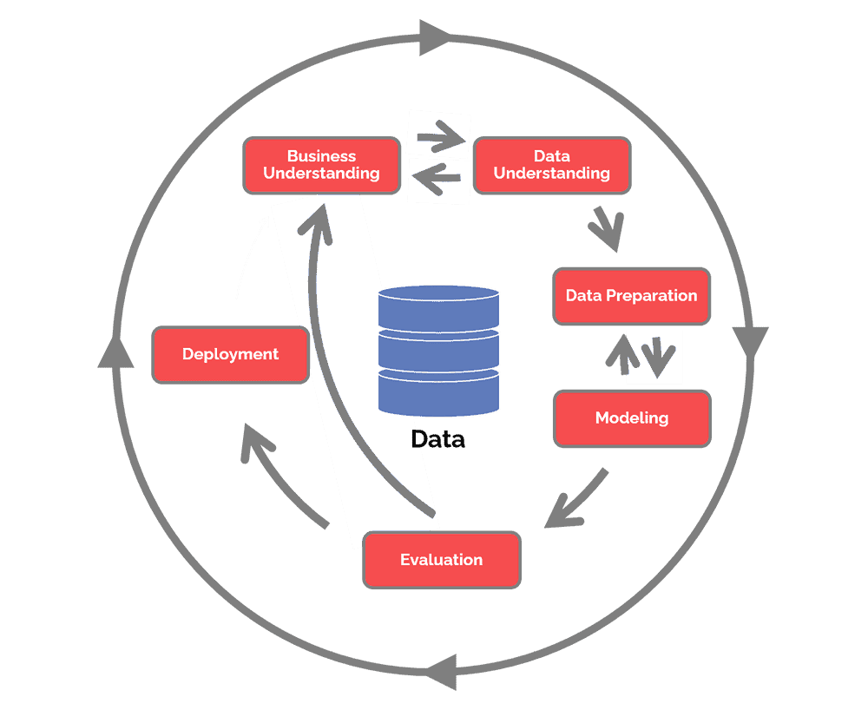
Data Science Lifecycle

Slide 4
TEXT LAYOUT 1
Project Overview
♦ Business Problem:
At the moment, applying for a home loan is a laborious procedure. It takes 2 to 3 days, so the applicant won't learn the results of their application until after those 2 to 3 days.
♦ Business Objective:
Help the user by getting information regarding the status of their loans in a matter of seconds.
♦ Hypothesis:
Machine learning may be used to forecast a future borrower's loan status based on historical data, greatly reducing the time it takes for them to discover their separate statuses.

Slide 5




TEXT LAYOUT 1
Process Overview / Solution

Slide 6
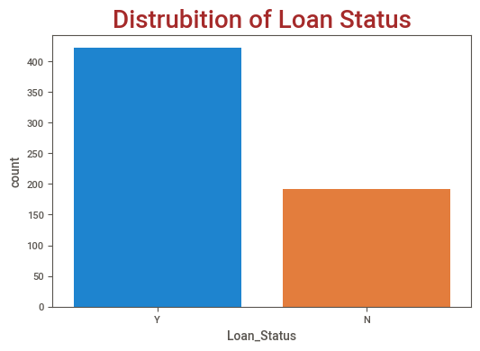
TEXT LAYOUT 1
Data (Historical Data)
♦ Train Data contains 614 Rows and total 13 columns
♦ Out of 13 columns there are 5 numerical columns
(4 float, 1 integer) and 8 object columns
♦ Target variable – Loan Status Y(422) and N (192)

Slide 7
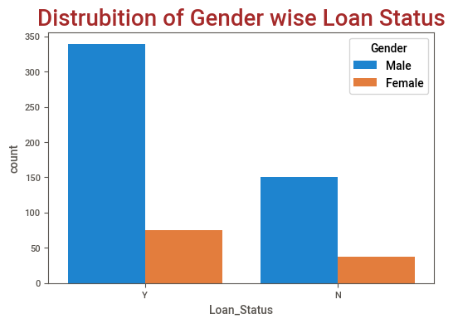
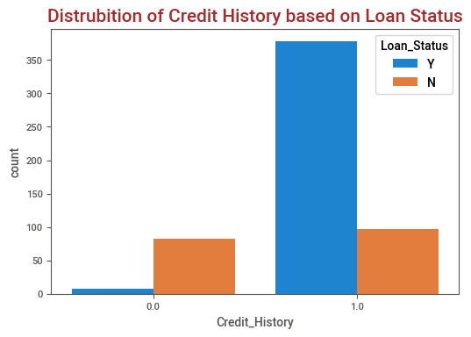
TEXT LAYOUT 1
Analysis

Slide 8
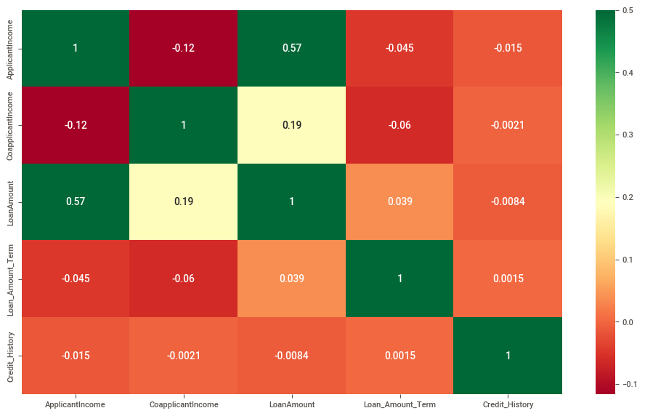
Analysis
There is a correlation between the applicant's income and the loan amount they applied for.

Slide 9
Modeling
• The RandomForestClassifier machine learning model is one that has been trained.
• Along with traditional machine learning models, AutoML is also applied.
• Custom-made machine learning model required pre-processing
• AutoML did not required pre-processing
• Results from AutoML and conventional machine learning models are equivalent.

Slide 10
Model Evaluation
 | AutoML | Custom-made ML
Accuracy | 78% | 77%
• Where accuracy is the total of all the model's correctly predicted outcomes over all predicted outcomes.

Slide 11
Recommendations
• Custom-made ML is better than AutoML
• We are fully aware of what was used, how it was used, and what algorithm was applied to accomplish the goal.
• If we can train and forecast in real time, it will benefit us and take less time to do so, although this use case may not allow for it.
• The ideal application for AutoML is as a foundational model.

